Slide 1
Data Structures
Tree – Introduction

Slide 2
Tree – Introduction

Slide 3
Data Structure –Tree
Introduction

Slide 4
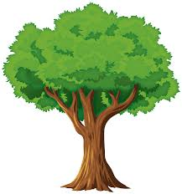
Data Structure –Tree
Introduction

Slide 5
Data Structure –Tree
Introduction
Non Linear data Structure
It is used to represent hierarchical tree structure

Slide 6
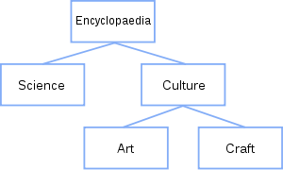
Data Structure –Tree
Introduction
Non Linear data Structure
It is used to represent hierarchical tree structure
Encyclopedia
Hierarchical organization of an encyclopedia

Slide 7
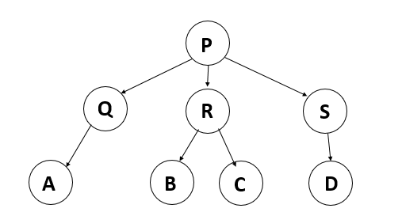
Data Structure –Tree
Introduction
Basic Terms

Slide 8
Data Structure –Tree
Introduction
Basic Terms

Slide 9
Data Structure –Tree
Introduction
Basic Terms
root

Slide 10
Data Structure –Tree
Introduction
Basic Terms
root
Leaf

Slide 11
Data Structure –Tree
Introduction
Basic Terms
root
Intermediate
Leaf

Slide 12
Data Structure –Tree
Introduction
Basic Terms
Height
A
B
C
D
E
F
G
H
The Height of a tree is the number of edges on the longest path between
a node and leaf

Slide 13
Data Structure –Tree
Introduction
Basic Terms
Height
A
1
B
C
2
D
E
F
G
3
H
The Height of a tree is the number of edges on the longest path between
a node and leaf

Slide 14
Data Structure –Tree
Introduction
Basic Terms
Height
A
1
Height of Tree =3
B
C
2
D
E
F
G
3
H
The Height of a tree is the number of edges on the longest path between
a node and leaf

Slide 15
Data Structure –Tree
Introduction
Types of Tree
Binary Tree
Ternary Tree
N - array Tree
AVL Tree
Red Black Tree

Slide 16
Data Structure –Tree
Introduction
Types of Tree
Binary Tree
Atmost 2 children
Ternary Tree
Atmost 3 children
N - array Tree
AVL Tree
Red Black Tree

Slide 17
Data Structure –Tree
Introduction
Types of Tree
Binary Tree
Atmost 2 children
Ternary Tree
Atmost 3 children
N - array Tree
AVL Tree
Red Black Tree
Application of Tree
Store hierarchical data, like folder structure, organization structure, XML/HTML data.
Syntax Tree : Used in Compilers

Slide 18
Binary Search Tree

